Slide 1
Literature and Cinema
B. A. Part II Semester III
Paper III

Slide 2
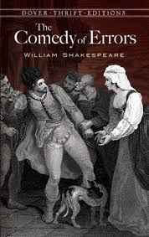

Slide 3
Comedy of Errors/Angoor
Locations:
Ephesus Shikarpur
Syracuse Dinkarpur

Slide 4
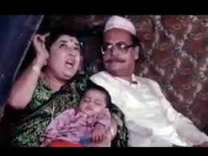
Egeon (Father of Antipholus)
Emillia (Mother of Antipholus)
Raj Tilak (Father of Ashok)
Shammi (Mother of Ashok)

Slide 5
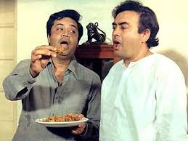
Antipholus of Ephesus
Dromio of Ephesus - Servant
Ashok R. Tilak from city
Bahadur from city (Ashok’s servant)

Slide 6
Antipholus of Syracuse
Dromio of Syracuse – Servant
Ashok R. Tilak from village
Bahadur from village

Slide 7
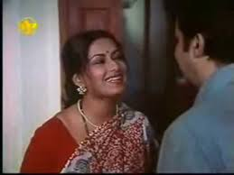
Adriana - Wife of Ephesus
Sudha (Wife of Ashok from city)

Slide 8
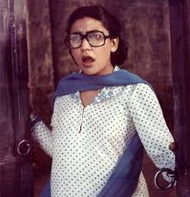
Luciana - Sister of Adriana
Tanu (Sister of Sudha)

Slide 9
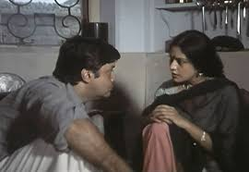
Nell - Adriana’s kitchen-maid and wife of Dromio
Prema (Sudha’s kitchen-maid and wife of Bahadur)

Slide 10
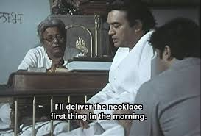
Angelo – Goldsmith
Chedilal- Jeweller

Slide 11
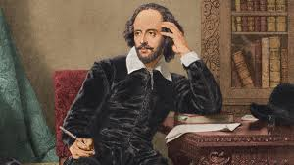
Writer V/S Director
William Shakespeare Gulzar

