Slide 1
The Dread Departure
A Play by Satish Alekar

Slide 2
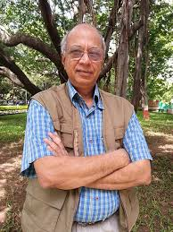
Satish vasant Alekar

Slide 3
Biography
Born in 1949
Important Marathi dramatist of the 20th century
Marathi playwright, actor and director
Founder member of well known Theatre Academy, Pune
Recipient of Padmashree Award
Recipient of Sangeet Natak Akademi Award

Slide 4
Important plays
Mickey ani Memsahib (1973)
Mahanirvan (1974)
Mahapoor (1975)
Begum Barve (1979)
Atirekee (1990)
Pidhijat (2003)

Slide 5
mahanirvan
Translated into English by Gauri Deshpande
English title is The Dread Departure
Divided into two acts

Slide 6
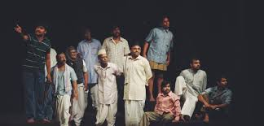
Main characters
Bhaurao: A middle aged/middle class man
Rama: Bhaurao’s wife
Nana: Bhaurao’s son
Neighbours
Watchman

Slide 7
Act I
Begins with death of Bhaurao
Wailing Rama; neighbours gathered
Preparations set for Bhaurao’s cremation
Waiting for Nana who has gone to play tournaments of Prisoner’s Base
With Nana’s arrival begins procession

Slide 8
At crematorium:
Private property; cremation not allowed
Neighbours disperse one by one
Only Nana and Bhaurao are left
Bhaurao speaks; Nana terrified
Bhaurao’s last wish to be cremated in the old crematorium
Nana drags the corpse of Bhaurao home
Ends Act I

Slide 9
Act II
10th day after Bhaurao’s death
Nana comes to crematorium; he is followed by Bhaurao
Bhaurao eats rice which actually is brought by Nana to make rice balls (an offering to the departed soul, i.e. Bhaurao)
Bhaurao informs him about his cut finger; Nana stitches the finger
Decaying the dead body of Bhaurao

Slide 10
At home:
Rama tells Nana about a person who wears suit and dark glasses; asks to invite him on the 13th day ceremony (“third from the left”)
Bhaurao attempts to meet Rama in the guise of “the third from the left”
Rama faints due to stink of Bhaurao
Nana revisits old crematorium; watchman demands Rs. 2000 as bribe

Slide 11
One insurance agent hands over Nana a cheque of Rs. 10, 000 which had been insured by Bhaurao
From that Nana gives Rs. 2000 to the watchman
Watchman allows Nana to cremate Bhaurao in the old crematorium
Bhaurao’s death wish is in this way fulfilled

Slide 12
