Slide 1
Toba tek singh
A short story by Sadat Hasan Manto

Slide 2
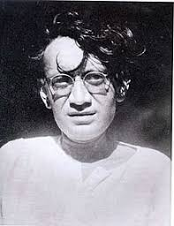
“बोल कि लब आज़ाद हैं तेरे बोल ज़बाँ अब तक तेरी है …”
Manto was a staunch supporter of the freedom of expression

Slide 3
Sadat Hasan Manto
Born in 1912; died in 1955
Pakistani writer, playwright
Urdu writer
Writer who wrote about harsh truths of society
Strong opponent of India’s Partition that took place in 1947

Slide 4
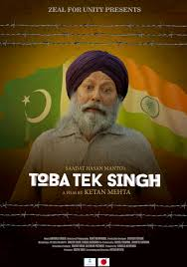
Toba Tek Singh
One of the classic stories
Severe criticism on the partition
Documents the pangs of partition
Relevant even today

Slide 5
The story
Setting: Lunatic asylum at Lahore
Transfer of power – transfer of communities (Hindu – Muslim – Sikh)
Transfer of lunatics
Hindu – Sikh lunatics will be shifted to India; Muslim lunatics will remain in Pakistan
All lunatics fail to understand what is mean by India and Pakistan

Slide 6
Restless lunatics due to transfer
“India is a place in India known for manufacturing cut-throat razors."
"I don't want to live in India and Pakistan. I'm going to make my home right here on this tree.“
A radio engineer with an MSc degree, a Muslim, … stripped off all his clothes, gave them to a guard and ran in the garden stark naked.

Slide 7
“I’m none other than Quaid-e-Azam Mohammed Ali Jinnah.”
“I’m none other than Master Tara Singh, the leader of the Sikhs.”
A Hindu lawyer from Lahore – heart broken due to failure in love – does not want to go to India – fears about his legal practice in India
Two Anglo-Indians – “Instead of bread, would they have to make do with measly Indian chapattis?”

Slide 8
Sardar Bishan Singh
"Uper the gur gur the annexe the bay dhayana the mung the dal of the laltain."
Living in asylum for fifteen years
Had not slept in fifteen years; would not lie down
Swollen feet due to standing continuously
Toba Tek Singh – his home town
Family/Daughter – Roop Kaur
Every one calls him TOBA TEK SINGH

Slide 9
“ये दाग़ दाग़ उजाला, ये शब-गज़ीदा सहर वो इन्तज़ार था जिस का, ये वो सहर तो नहीं”
Toba Tek Singh craves for his homeland
He incessantly inquires – ‘Is Toba Tek Singh in India or Pakistan’
At Indian border, Toba Tek Singh comes to know that his home town is in Pakistan
He refuses to go to India.
Stands firmly on the ground for the whole night.
Just before sunrise, he screams; dies; lies on a land which is neither in India nor in Pakistan

Slide 10
“ये वो सहर तो नहीं जिस की आरज़ू लेकर
चले थे यार कि मिल जायेगी कहीं न कहीं
फ़लक के दश्त में तारों की आख़री मंज़िल
कहीं तो होगा शब-ए-सुस्त मौज् का साहिल
कहीं तो जा के रुकेगा सफ़िना-ए-ग़म-ए-दिल
अभी चिराग़-ए-सर-ए-राह को कुछ ख़बर ही नहीं
अभी गरानि-ए-शब में कमी नहीं आई
नजात-ए-दीद-ओ-दिल की घड़ी नहीं आई
चले चलो कि वो मंज़िल अभी नहीं आई
- Faiz Ahmad Faiz

